Slide 1
Social Testing: A Framework to support adoption of continuous delivery by SME’s
Jonathan Dunne, David Malone, Jason Flood.
CSCESM2015 – 21st September

Slide 2
Agenda:
1. Introduction
2. Background Research
3. Dataset
4. Analysis
5. Results
6. Conclusion

Slide 3
Introduction
Continuous delivery (CD) is an approach to software engineering which allows for rapid development, test and delivery of software.
Small to medium enterprises (SME’s) represent 79% of all employment with the EU. Annual turnover in excess of €440 billion.
Nine out of ten SME’s in Europe have less than ten employees, which makes the adoption of CD a non-trivial effort.
SME’s need a framework which can best utilise their limited in-house test resources and their greatest test asset: the customer.
The core idea of our framework is for the in-house test teams to focus on high value test areas, while incentivising the customer to find low impact field defects

Slide 4
Background Research
Continuous delivery
Allows software companies to develop, test and release software in short, discrete delivery cycles.
Releasing software with a low number of changes allows the rapid release of software.
Key evangelists: Facebook, Google and Netflix
Bug Bounty Programs
A bug bounty program is a scheme whereby software companies offer a reward to users that find defects within their software.
Mainly used to flush out security defects.
Key players: Facebook, Google and Microsoft.
Related Studies
Brooks and Robinson : Customers and in-house teams find similar types of GUI defects.
Moritz : In-house test environments did not match customer deployment patterns.
Gittens : Larger in-house test coverage does not reduce field defects. Rather in-house tests need to be targeted.
Sullivan & Chilarege : Newer software components generate a higher number of defects than legacy components.

Slide 5
Data Set
Our study collected data from:
1400 field defects from a large cloud based system.
Data was collected over a 12-month period (Jan - Dec)
Four main components: Business support System (BSS) Collaboration, Email and Social.
Three data centres deployed globally.
Our study aims to answer the following questions:
How do field defects impact the customers overall user experience?
What components are likely to yield field defects?
What data centres are likely to yield more field defects?
What types of defects do customers typically find?

Slide 6
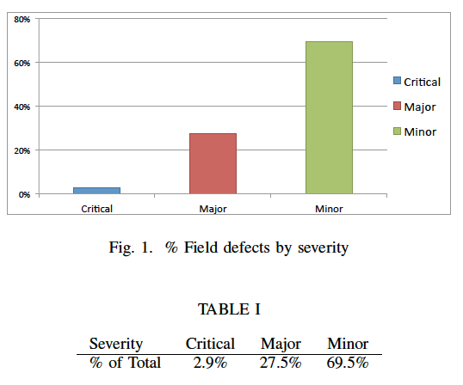
Analysis – Defect Impact
Fig. and Table I show the percentage of all defects of each severity type.
The bulk of defects found by the customer were minor impact. (70%)
Major impact defects were less common with approximately (28%) found.
Critical impact defects were quite rate with only 3% of being critical in nature.

Slide 7
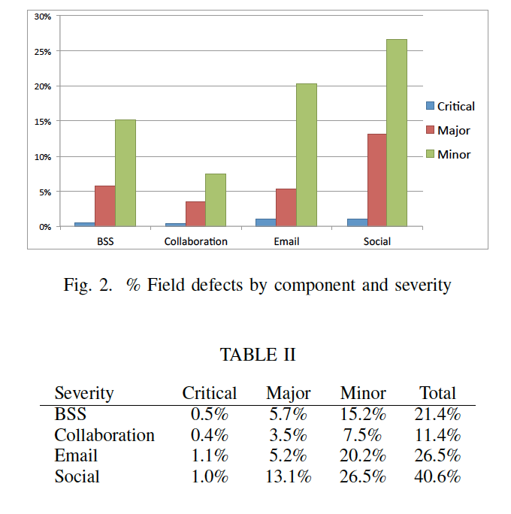
Analysis – Defect Component
Fig. 2 and Table II shows the percentage of the total defects broken down by component and their severity.
The social component contained the most defects with almost (41%).
Email was next with approximately (27%).
The BSS component had around (21%) of all defects.
The collaboration component had the least number of defects with (11%).

Slide 8
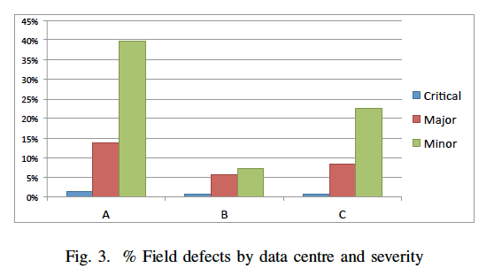
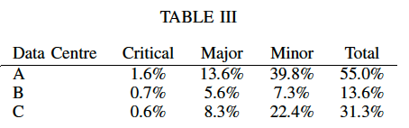
Analysis – Data Centre
Fig. 3 and Table III shows the percentage of the total defects broken down by Data centre and severity.
Data centre A (High usage) recorded the highest number of field defects with 55%
Data centre B (Medium usage) recorded the next highest with just over (31%).
Data centre C (Low usage) recorded the lowest number of field defects with almost (14%).

Slide 9
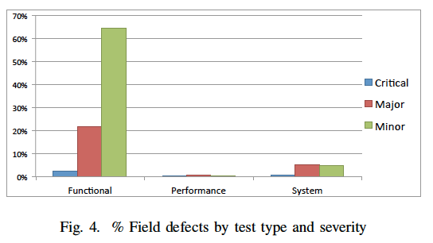
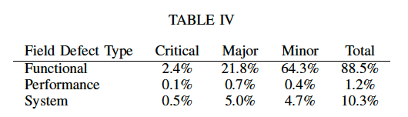
Analysis – Defect Type
Fig. 4 and Table IV shows the percentage of the total defects broken down by test type and severity.
Functional defects were the most commonly found with almost (89%)
System defects were next with (10%) raised by the customer.
Performance defects were the least common with only (1%) found in the field.

Slide 10
Results
Defect Impact:
The customer is good at finding low impact defects (70% of total) .
A bug bounty scheme could motivate users to find more of these types of problems.
Defect Component:
Customers found most field defects in the social and email components by proportion.
Conditional probabilities tell us that a customer is more likely to find a minor impact defect in the email component (P(minor|email)=0.762).
Bounty schemes can be tailor made to target specific components on a per release basis.
Data Centre:
Proportionally more field defects were raised on the high and medium usage data centres.
Conditionals tell us that for high and medium use data centres users are three time more likely to find a minor impact than a major impact defect.
Bounty schemes could target minor impact defects on high usage data centres.
Defect Type:
Customers are more likely to find functional defects than any other type.
Bounty schemes can prioritize minor functional defects leaving in-house test teams to re-focus on high and medium System and Performance testing

Slide 11
Conclusion
Previous studies have shown that:
Field defect analysis is a worthwhile exercise.
Bug bounty programs provide an incentive for users to improve software quality.
Our study has shown that:
Customers are useful at finding certain types of defects: Functional low impact.
Field defect data can be used to create a test in-house frameworks.
These frameworks allow test team to focus on high value test areas.
Future work:
Study of in-house defect deferrals vs field defects found.

